Slide 1
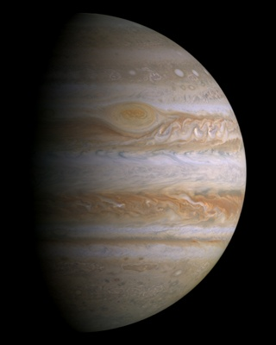
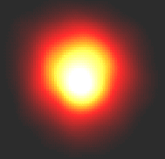
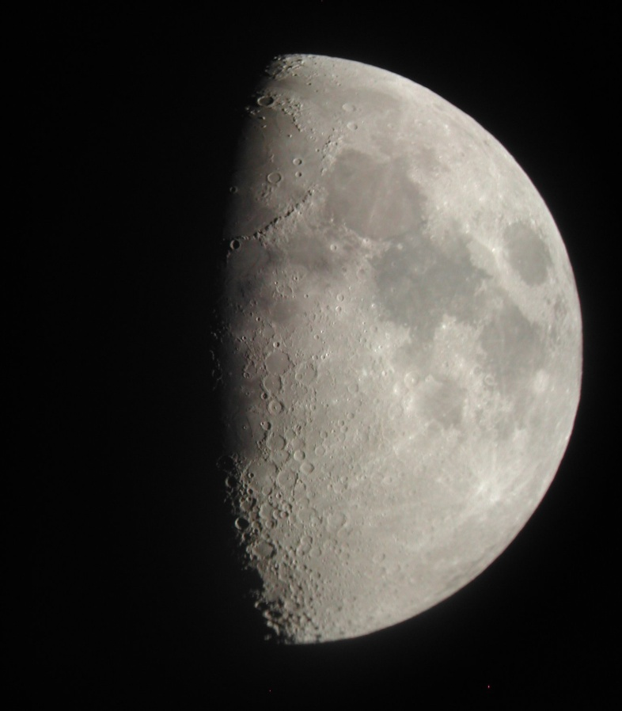
Journey to Jupiter

Slide 2
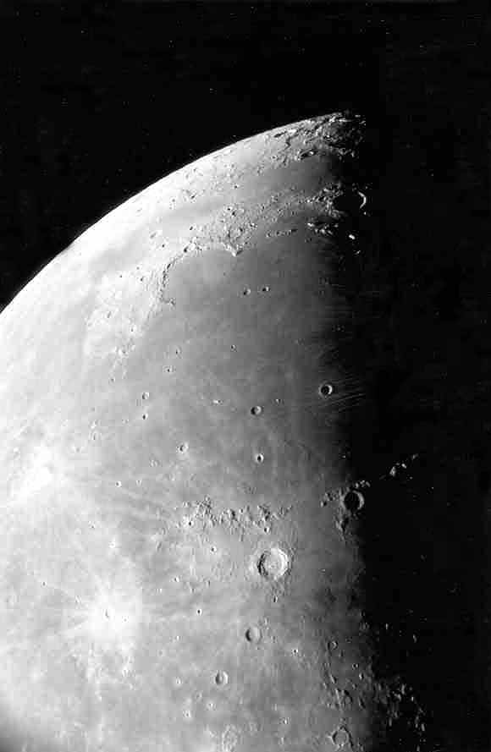
Moon Maré
Moon maria as seen through our telescope.
Photo by
Jim Fullerton

Slide 3
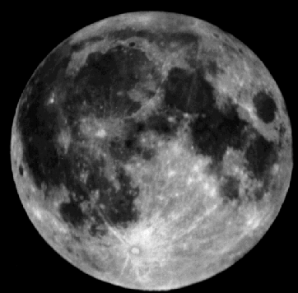
Moon Maré
The maria (maré) are the smooth dark areas on the surface of the Moon.
Mare
Highlands

Slide 4
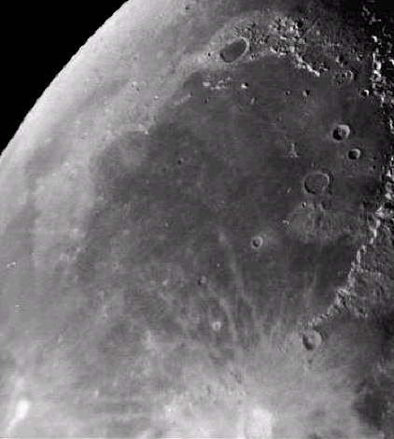
Moon Maré
The maria were formed about 3.2 to 4 billion years ago.
Lava flowed through cracks in the lunar surface and filled in low laying areas. These cracks were NOT developed because of an impact. Scientists are not sure what caused them.
Maré Imbrium

Slide 5
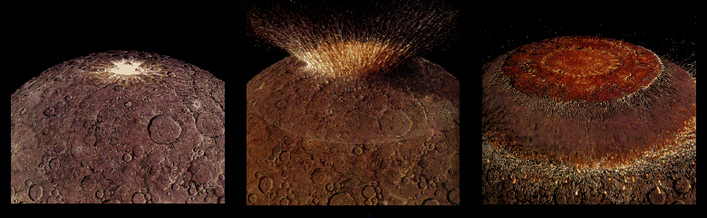
Moon Maré
Four billion years ago the impact of a very large asteroid formed a huge multi-ringed basin which thinned and fractured the lunar crust.

Slide 6
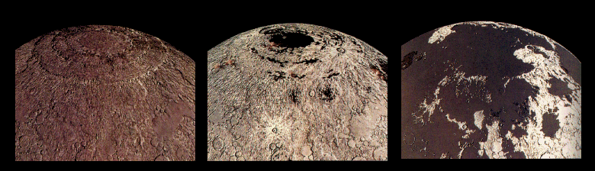
Moon Maré
Thin, lava from beneath the moon’s crust flowed out and flooded the low regions of the lunar surface, filling many existing craters.

Slide 7
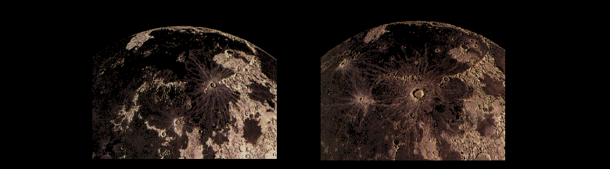
Moon Maré
Less than a billion years after it began, the lava stopped flowing out onto the surface of the Moon and new craters began to form on top of the maria.

Slide 8
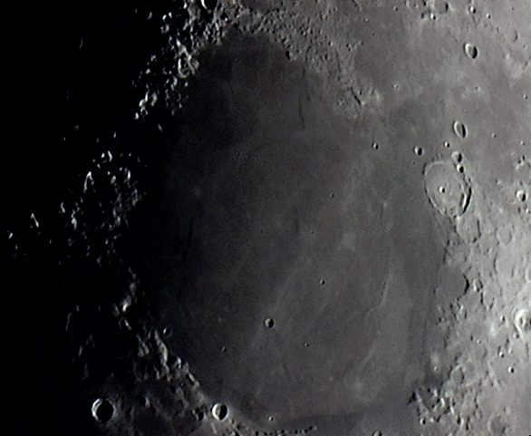
Older & Larger Craters
Mare Imbrium
Mare Serenitatis
Many older, larger craters on the near-side of the Moon have been completely filled with lava – about 31% of the near-side.

Slide 9
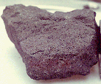
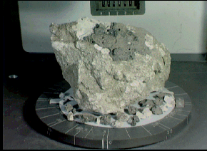
Moon Maré
Lunar rock samples from the moon’s maria are dark colored rocks.
Rock samples from the highland regions are much lighter in color.

Slide 10
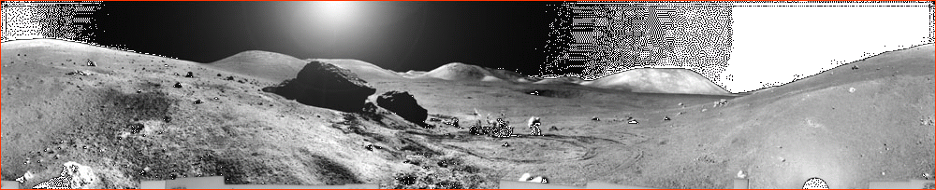
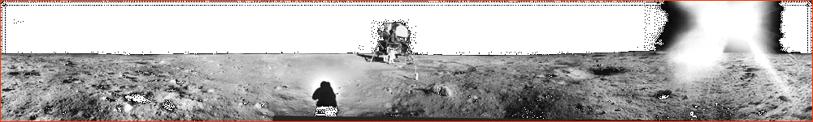
One of these pictures shows the lunar surface from a maré, the other from the highlands.
Can you tell which is which?

Slide 11
Moon Maré
The highlands are rugged.
The maré are relatively smooth and flat.

Slide 12
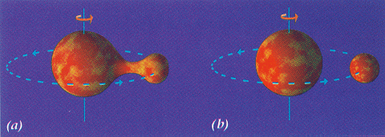
Moon Formation
In the early 20th century there were three competing theories of the Moon’s origin.
1) The Fission Theory:
The Moon was flung off a newly forming, rapidly spinning, molten Earth like mud off a bicycle tire.

Slide 13
Moon Formation
Moon
Earth
2) The Capture Theory:
The Moon formed elsewhere and was captured when it came too close to Earth’s gravitational influence.

Slide 14
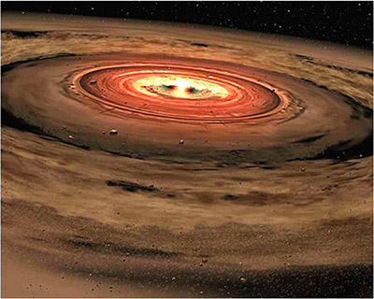
Moon Formation
3) Nebular Accretion Theory:
The Moon formed at the same time as the Earth out of the material that formed our solar system.

Slide 15
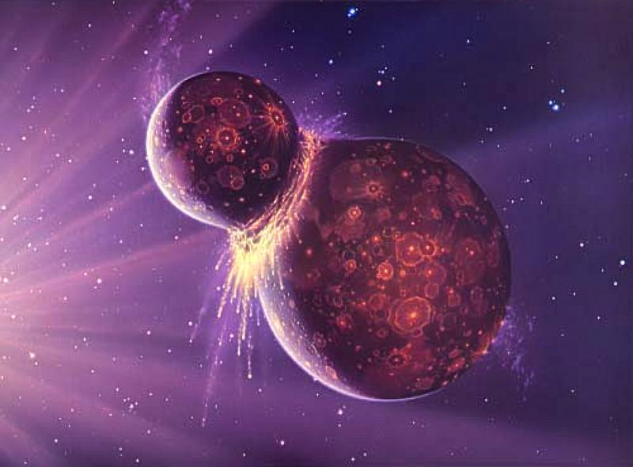
Moon Formation
The most widely accepted theory today of the Moon’s formation is the Collision Theory.
Collision Theory:
A Mars-sized object hit Earth a glancing blow early in its formation knocking off chunks of both planets that later came together to form the Moon.

